Slide 1
The Digital Logic Level
CHAPTER 3

Slide 2
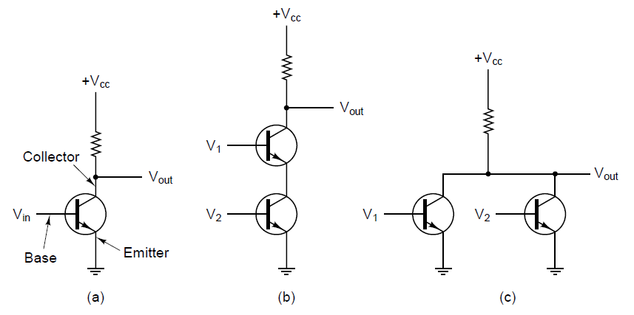
Gates and Boolean Algebra (1)

Slide 3
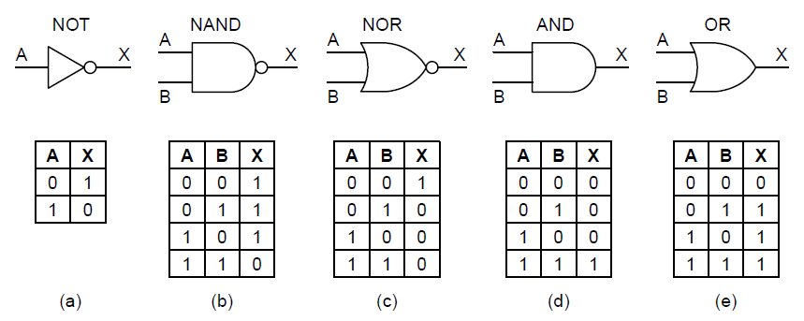
Gates and Boolean Algebra (2)

Slide 4
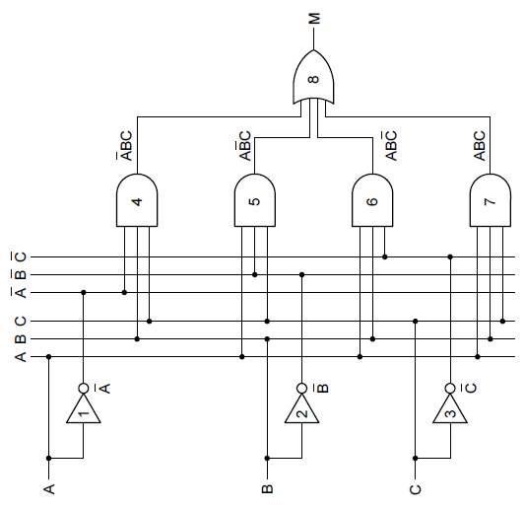
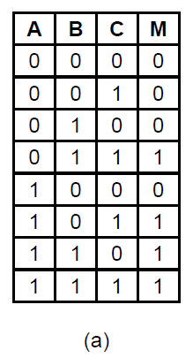
Boolean Algebra
(b)

Slide 5
Implementation of Boolean Functions
Write truth table for function
Provide inverters to generate complement of each input
Draw AND gate for each term with 1 in result column
Wire AND gates to appropriate inputs
Feed output of all AND gates into an OR gate

Slide 6
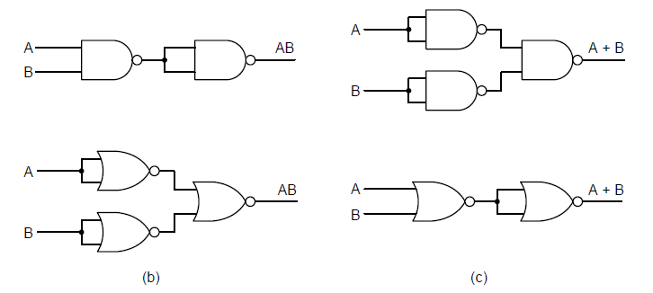
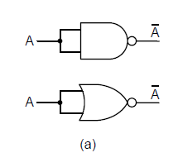
Circuit Equivalence (1)

Slide 7
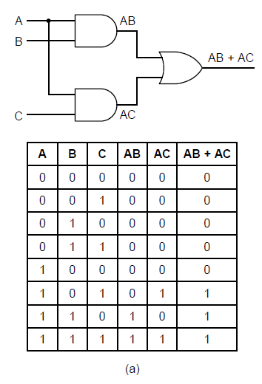
Circuit Equivalence (2)

Slide 8
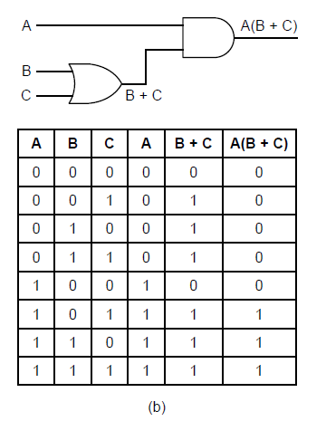
Circuit Equivalence (3)

Slide 9
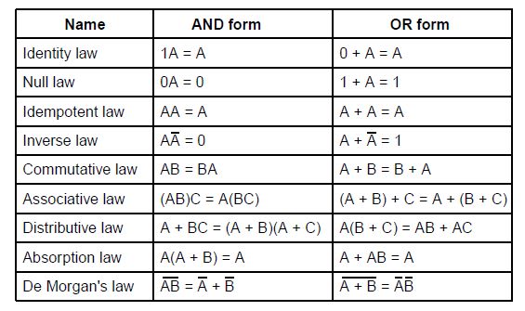
Circuit Equivalence (4)

Slide 10
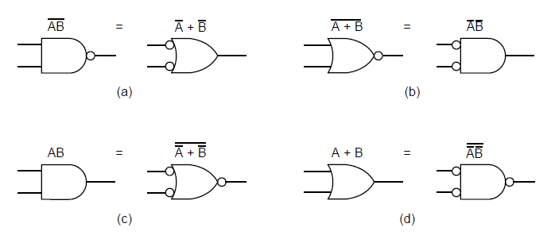
Circuit Equivalence (5)

Slide 11
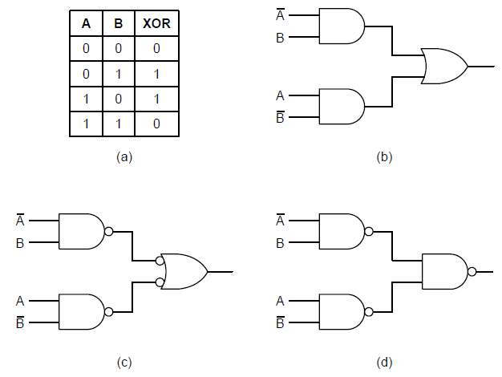
Circuit Equivalence (6)

Slide 12
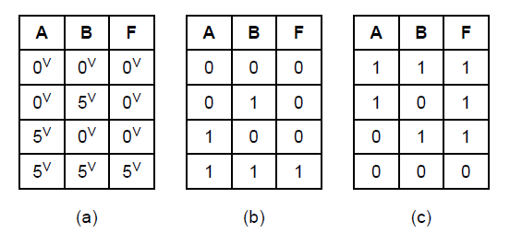
Circuit Equivalence (7)

Slide 13
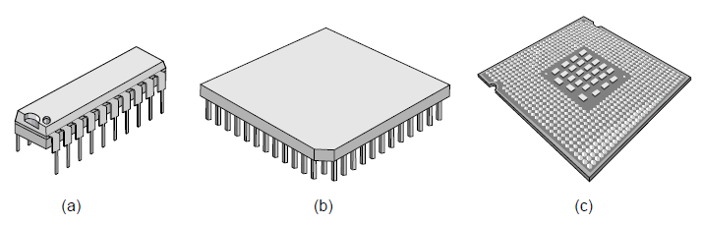
Integrated Circuits

Slide 14
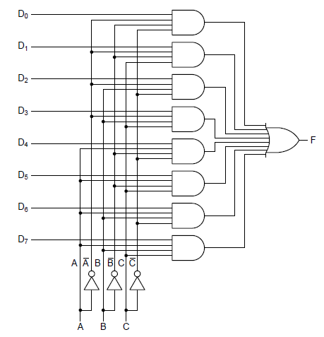
Multiplexers (1)

Slide 15
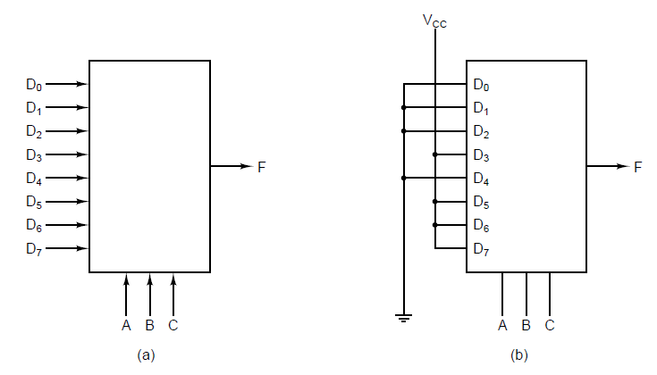
Multiplexers (2)

Slide 16
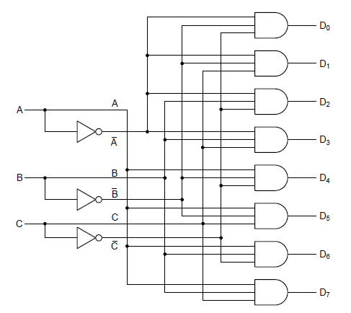
Decoders

Slide 17
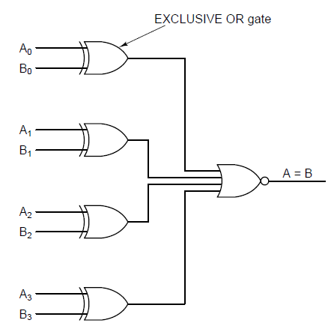
Comparators

Slide 18
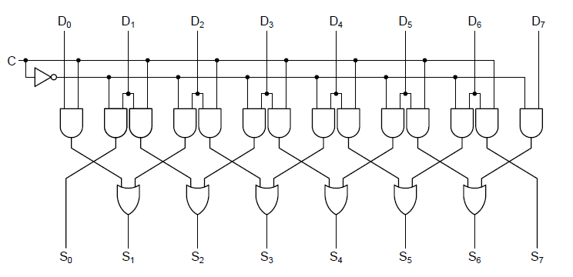
Arithmetic Circuits (1)

Slide 19
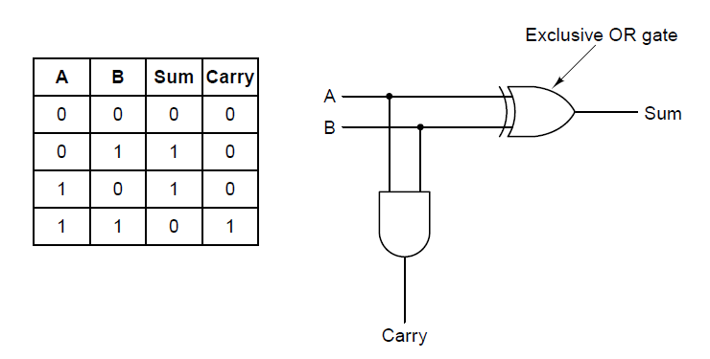
Arithmetic Circuits (2)

Slide 20
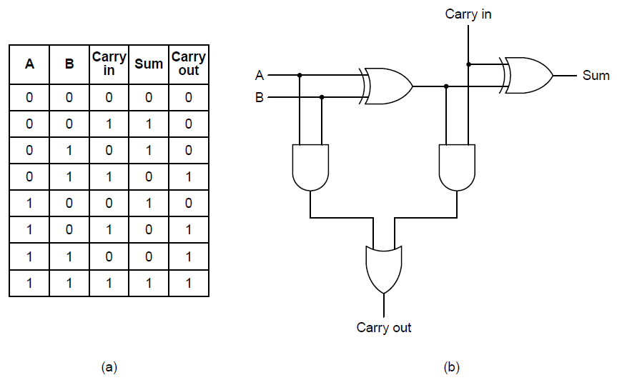
Arithmetic Circuits (3)

Slide 21
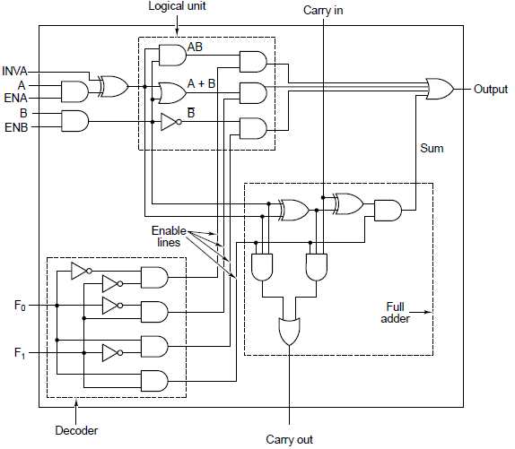
Arithmetic Logic Units (1)

Slide 22
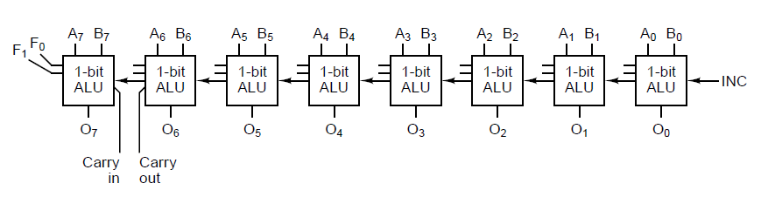
Arithmetic Logic Units (2)

Slide 23
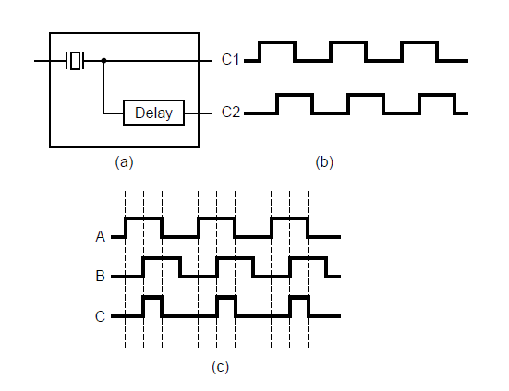
Clocks

Slide 24
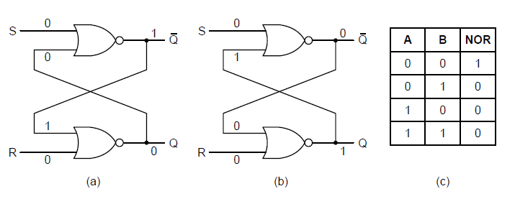
Latches
Figure 3-21. (a) NOR latch in state 0. (b) NOR latch in state 1.
(c) Truth table for NOR.

Slide 25
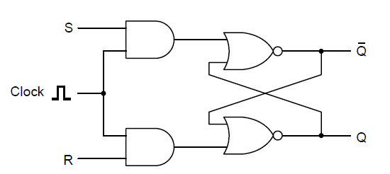
Clocked SR Latches

Slide 26
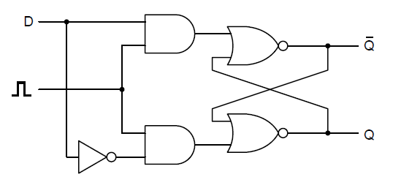
Clocked D Latches

Slide 27
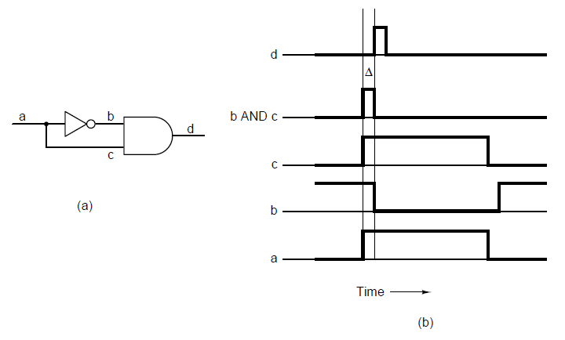
Flip-Flops (1)

Slide 28
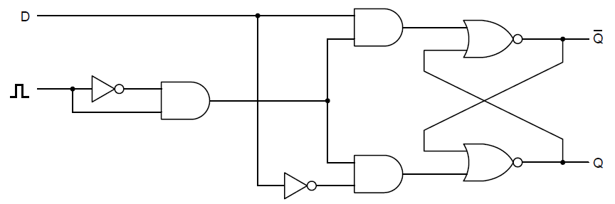
Flip-Flops (2)

Slide 29
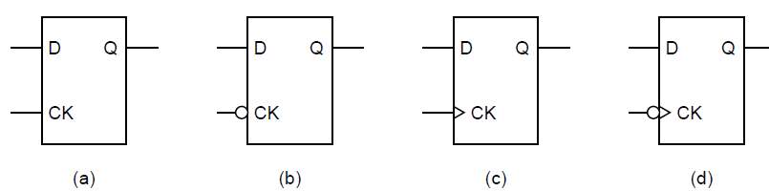
Flip-Flops (3)

Slide 30
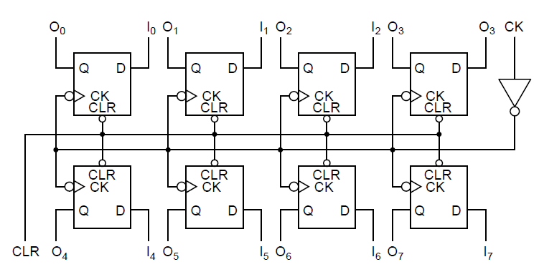
Memory Organization (1)

Slide 31
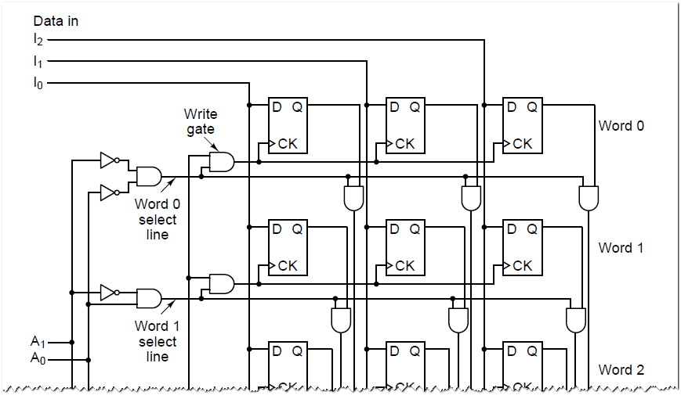
Memory Organization (2a)

Slide 32
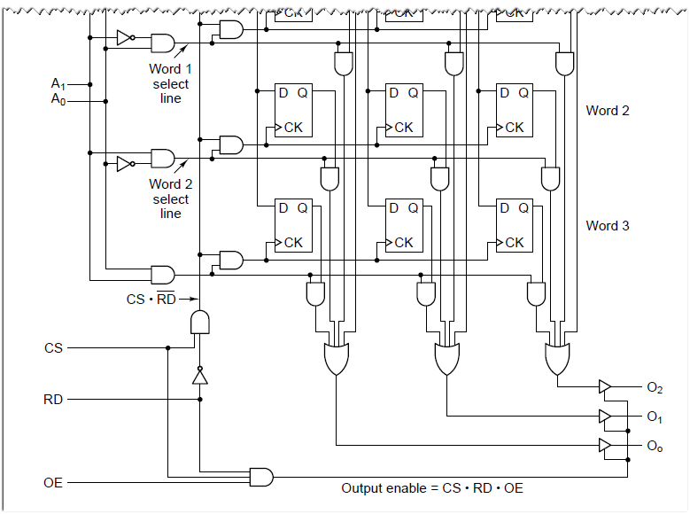
Memory Organization (2b)

Slide 33
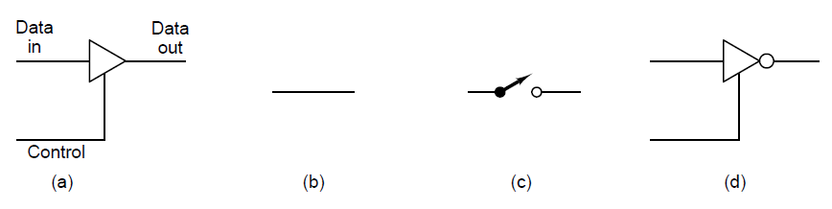
Memory Organization (3)

Slide 34
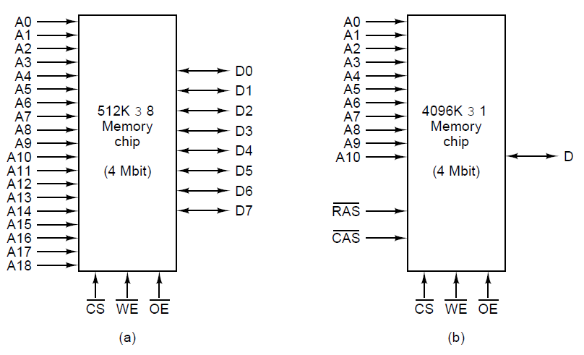
Memory Chips (1)

Slide 35
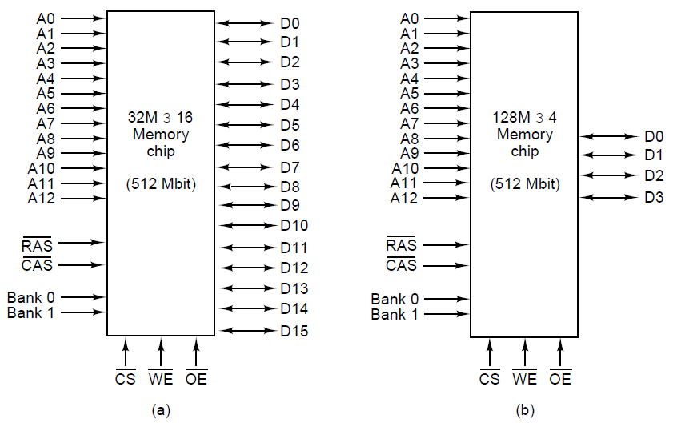
Memory Chips (2)

Slide 36
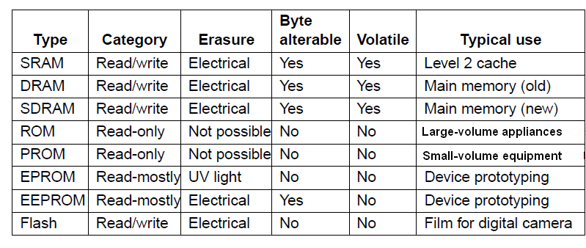
Nonvolatile Memory Chips(2)
Figure 3-32. A comparison of various memory types.

Slide 37
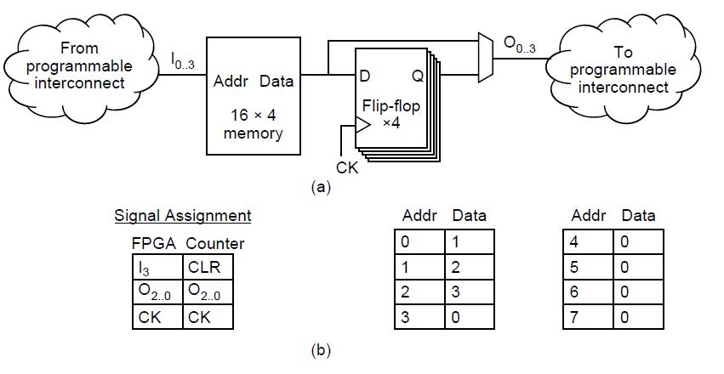
Field-Programmable Gate Arrays

Slide 38
CPU Chip Control Pins
Bus control
Interrupts
Bus arbitration
Coprocessor signaling
Status
Miscellaneous

Slide 39
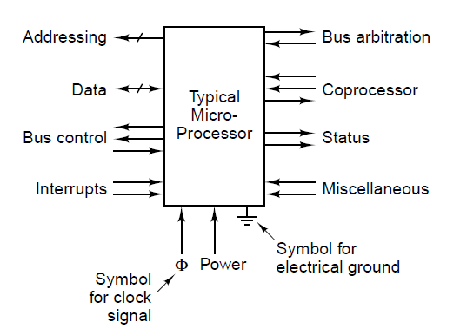
CPU Chips

Slide 40
Typical Microprocessor External Interface
Address bus (A0…An): output; selects memory or I/O target.
Data bus (D0…Dm): bidirectional; tri-stated; shared by devices.
Bus control: RD/WR, MEM/IO (or byte-enable), READY/WAIT—defines cycle & pacing.
Interrupts: IRQ/NMI inputs; priority, masking, and vectoring.
Bus arbitration: request/grant signals for DMA or other bus masters.
Coprocessor interface: handshake/status for offloading ops (e.g., FPU).
Status outputs: code vs data, user vs supervisor, bus-cycle state.Miscellaneous: RESET, HALT, TEST/ERROR, CLK OUT, boot-mode pins.

Slide 41
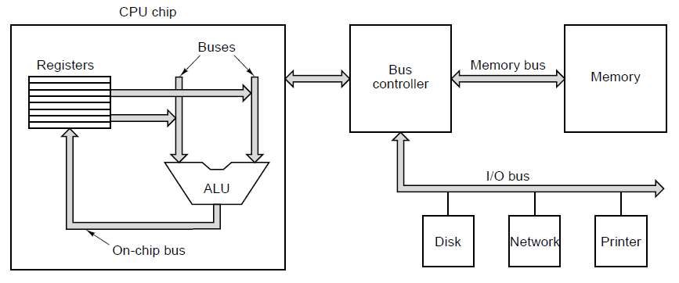
Computer Buses (1)
Figure 3-35. A computer system with multiple buses.

Slide 42
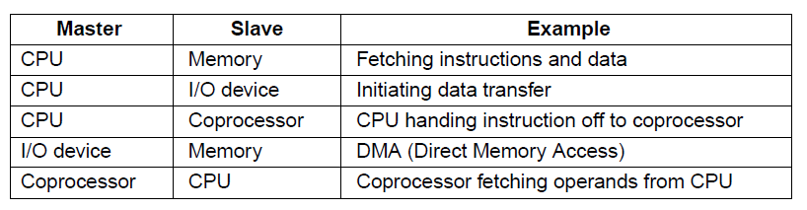
Computer Buses (2)

Slide 43
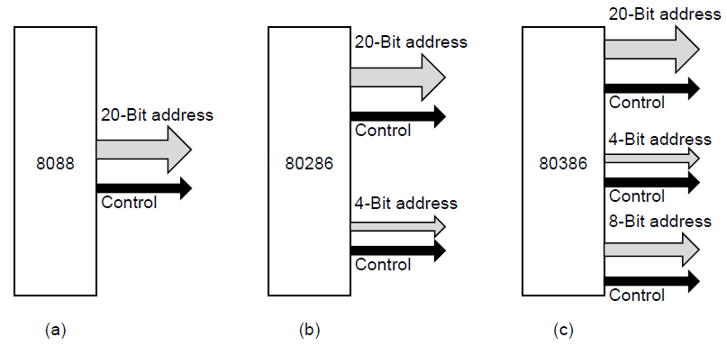
Bus Width

Slide 44
Impact of Address/Data Bus Width
Address width ⇒ addressable space (not speed).
8088/8086: 20-bit ⇒ 1 MB. 80286: 24-bit ⇒ 16 MB (adds A20–A23). 80386: 32-bit ⇒ 4 GB (adds A24–A31).
Data width ⇒ bytes per transfer & cycles per word.
Bandwidth scaling (roughly): BW ≈ data_width × bus_clock × efficiency.
Control & byte-enables grow with width. More chip-selects/byte-enable lines to support partial writes and alignment; more pins, ...
Key takeaway: Address width → capacity. Data width → throughput.

Slide 45
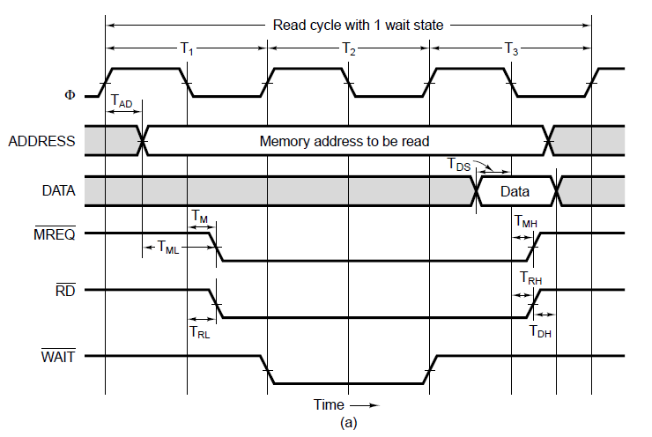
Synchronous Buses (1)

Slide 46
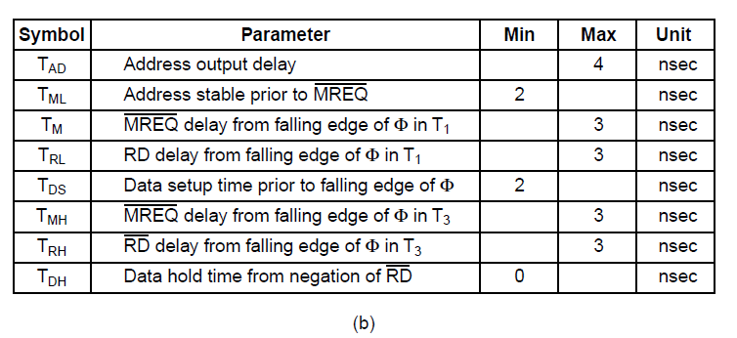
Synchronous Buses (2)
Figure 3-38. (b) Specification of some critical times.

Slide 47
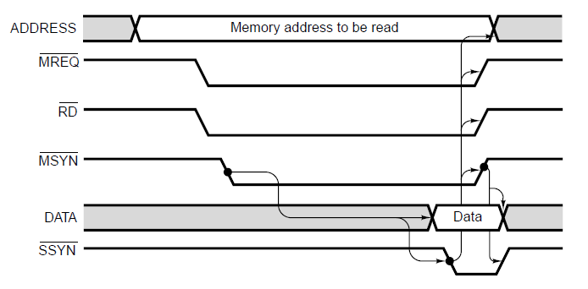
Asynchronous Buses

Slide 48
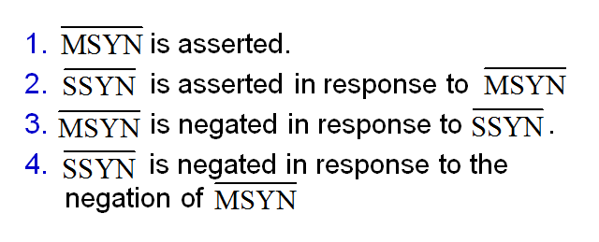
Four Events of Full-Handshake

Slide 49
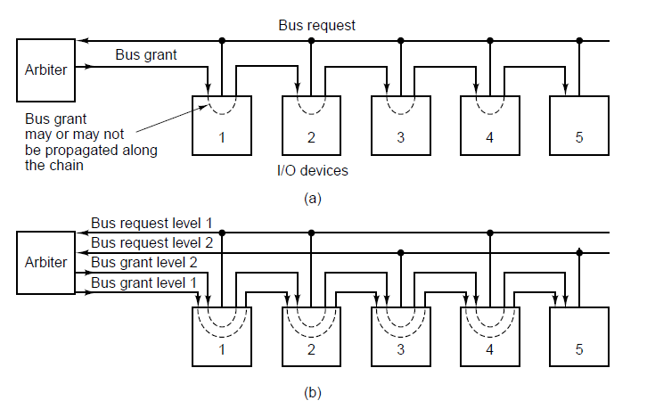
Bus Arbitration (1)

Slide 50
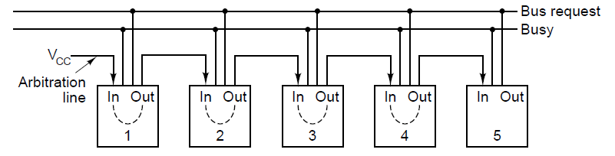
Bus Arbitration (2)

Slide 51
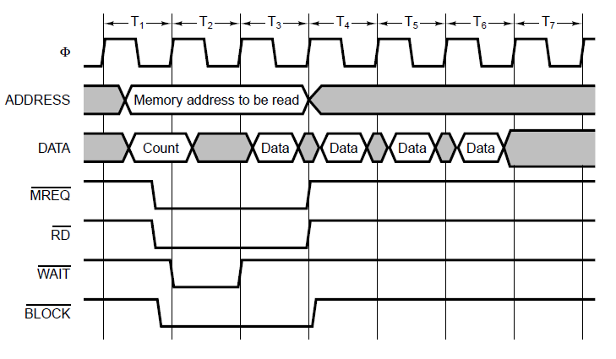
Bus Operations (1)

Slide 52
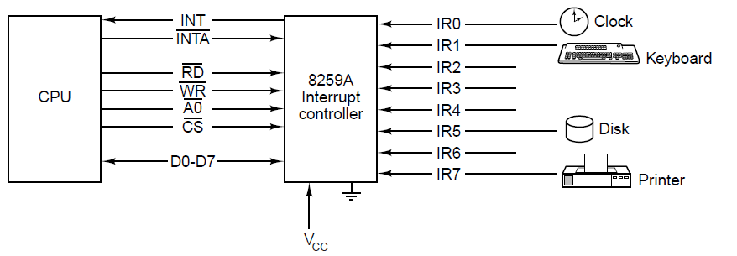
Bus Operations (2)

Slide 53
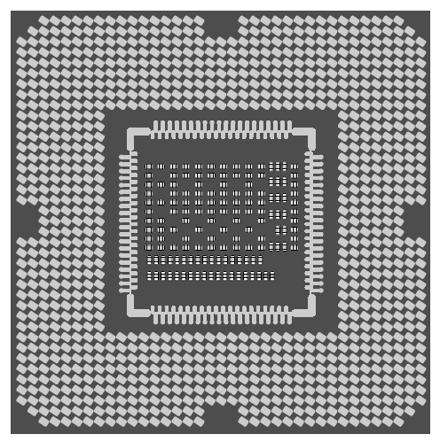
The Intel Core i7

Slide 54
The Intel core i7
64 bit CPU, 2-6 cores
Compatible with 8088 CPU
> 1 billion transistors (>1 miljard)
Line width ~a couple of nm
Clock frequency between 3,5 and 4 GHz
Hardware multithreading ( called hyperthreading by Intel)
L1 cache (split, 32K instruction cache, 32K data cache), L2 cache (unified, a couple of hunderds of KB), L3 cache (couple of MB)
Snoops
QPI
150 W power consumption (5 power states, full active to deep sleep)…thermal throtling!

Slide 55

The Core i7’s Logical Pinout

Slide 56

Chipset (DMI)

Slide 57

Chipset (DMI)

Slide 58
Pipelining on Core i7’s DDR3 Memory Bus
Three steps of memory requests
Activate phase – opens DRAM memory row, ready for access
Read or Write phase – multiple accesses can be made to individual words
Precharge phase – closes DRAM memory row, prepare for next activate

Slide 59

Pipelining

Slide 60

The PCI Bus (1)

Slide 61

PCI Bus Arbitration

Slide 62

PCI Bus Signals (1)

Slide 63

PCI Bus Signals (2)

Slide 64

PCI Bus Transactions

Slide 65

The PCI Express Architecture

Slide 66

The PCI Express Protocol Stack (1)

Slide 67
The PCI Express Protocol Stack (2)
Each transaction uses 1 of 4 address spaces:
Memory space for ordinary reads and writes)
I/O space (for addressing device registers)
Configuration space for system initialization, etc.)
Message space for signaling, interrupts, etc.)

Slide 68
The Universal Serial Bus (1)
Goals of USB developers:
Users must not have to set switches or jumpers
Users must not have to open the case to install new devices
There should be only one kind of cable
I/O devices should get power from the cable
Up to 127 devices should be attachable to a single computer
The system should support real-time devices (e.g., sound)
Devices should be installable while the computer is running
No reboot should be needed after installing a new device
The bus and devices should be inexpensive to manufacture

Slide 69

The Universal Serial Bus (2)
Figure 3-58. The USB root hub sends out frames
every 1.00 msec.

Slide 70

I/O Interfaces

Slide 71
Memory mapped I/O (MMIO)
Given an address bus with 16 lines and the following memory and I/O module(s)
2 KB EPROM (11 address lines)
2 KB RAM (11 address lines)
1 PIO module (2 address lines)
Choose suitable adress ranges for easy decoding:
First 2 KB => EPROM (MSb 5 bits are 0)
2 KB immediately starting at address 8000H (MSb 1, the other 4 MSb’s are zero)
Last addresses (14 MSb’s are all 1)

Slide 72

Address Decoding

Slide 73

Full address decoding

Slide 74

Partial address decoding

Slide 75
End
CHAPTER 3

